Slide 1
Random Forest
-- Mounika Voriganti

Slide 2
Introduction
Random Forest is a popular machine learning algorithm that belongs to the supervised learning technique.
Used in both regression and classification.
It is based on the concept of ensemble learning, which is a process of combining multiple classifiers to solve a complex problem and to improve the performance of the model.

Slide 3
Introduction
"Random Forest is a classifier that contains a number of decision trees on various subsets of the given dataset and takes the average to improve the predictive accuracy of that dataset." Instead of relying on one decision tree, the random forest takes the prediction from each tree and based on the majority votes of predictions, and it predicts the final output.

Slide 4
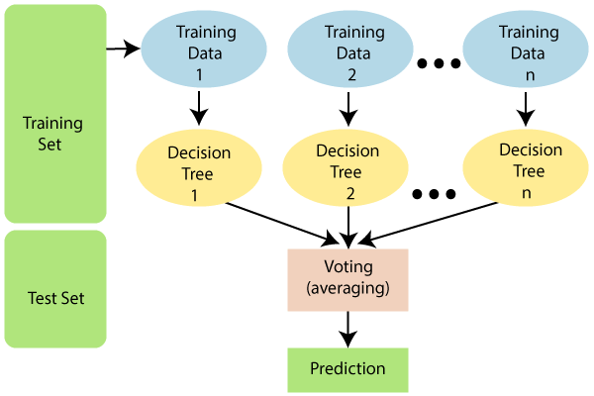

Slide 5
Why ?
It takes less training time as compared to other algorithms.
It predicts output with high accuracy, even for the large dataset it runs efficiently.
It can also maintain accuracy when a large proportion of data is missing

Slide 6
Applications
There are mainly four sectors where Random forest mostly used:
Banking: Banking sector mostly uses this algorithm for the identification of loan risk.
Medicine: With the help of this algorithm, disease trends and risks of the disease can be identified.
Land Use: We can identify the areas of similar land use by this algorithm.
Marketing: Marketing trends can be identified using this algorithm.

Slide 7
Advantages
Random Forest is capable of performing both Classification and Regression tasks.
It is capable of handling large datasets with high dimensionality.
It enhances the accuracy of the model and prevents the overfitting issue.

Slide 8
Disadvantages
Although random forest can be used for both classification and regression tasks, it is not more suitable for Regression tasks.

Slide 9
Thank you

